Slide 1
Thermal Mass Storage Weekly Meeting
February 16, 2024

Slide 2
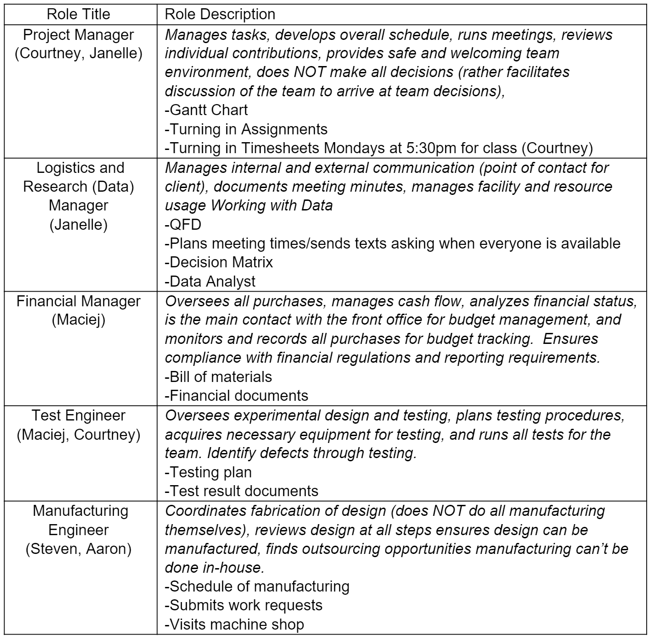
Roles

Slide 4
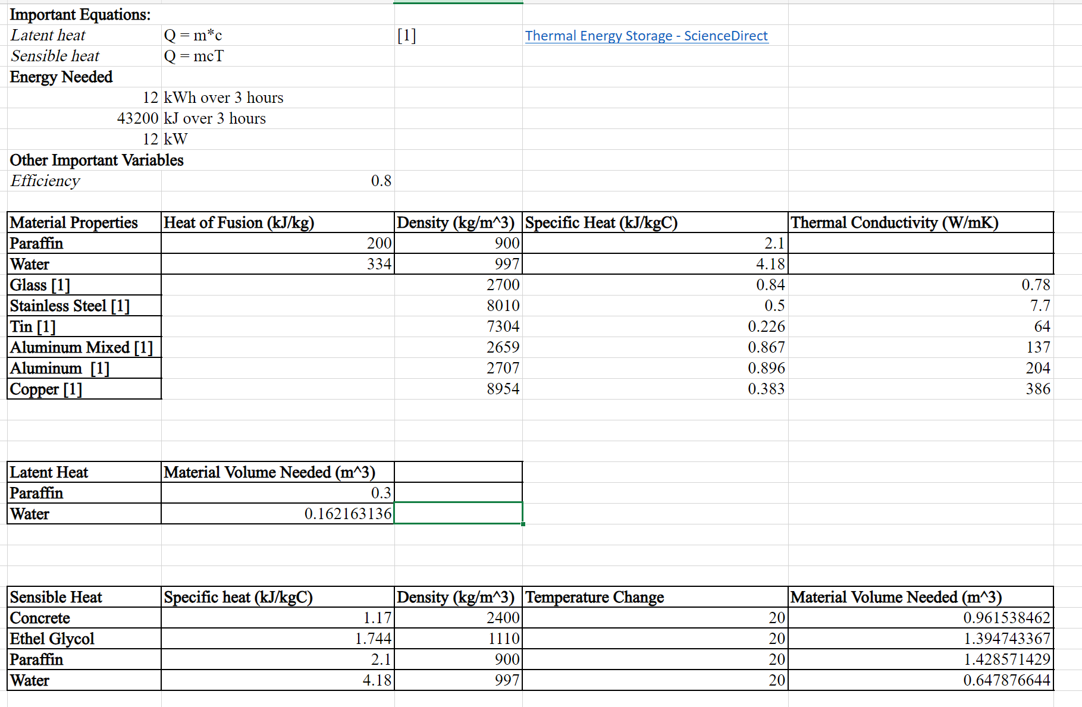
Material Analysis

Slide 5
Model

Slide 6
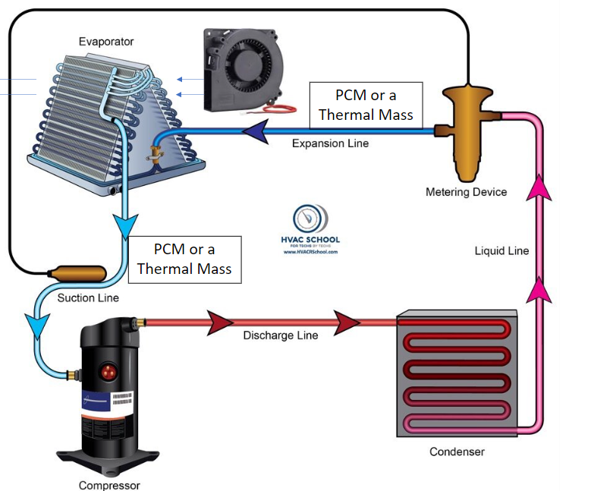
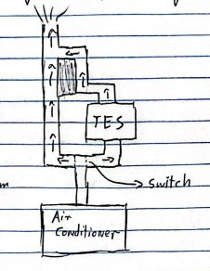
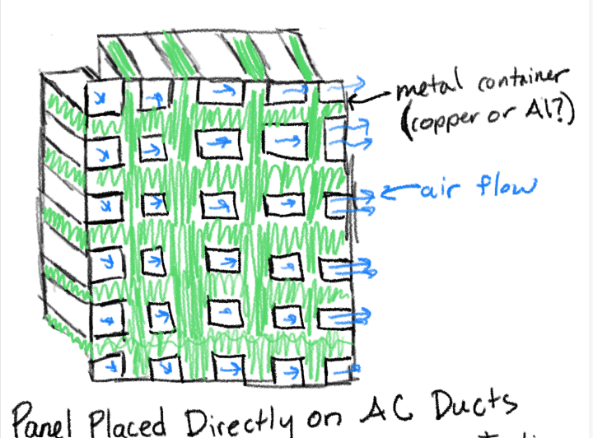

Slide 7
Questions- Final Thoughts- Overview
Analysis memo coming up

